Slide 1
QUERY CHATBOT
A small talk with machine
Team Mentor:
Mrs. P Srilakshmi
Assistant Professor
Cse Department
Presented by:
K Madhavi Prathyusha
R Iswarya Krishna
M Yashua Augustine
A Sai Kumar

Slide 2
Contents
Introduction
Abstract
Proposed System
Requirements
Design Process
Implementation
Flow Chart
Overview
Conclusion

Slide 3
Introduction
In our daily we life we come across various digital services that understand human capabilities. Chatbot is one of them.
Chatbots – also known as “conversational agents” – are software applications that mimic written or spoken human speech for the purposes of simulating a conversation or interaction with a real person.
Chatbots are smarter, more responsive, and more useful and we are likely to see even more of them in the coming years.

Slide 4
Abstract
Our project is to create a chatbot using Machine Learning and Natural Language Processing which is used for solving queries of Pragati Engineering College
We are likely to include details like teaching staff, extracurricular activities, placement opportunities, upcoming exams, result details etc.,
Proposed idea
At present we are having college website but it is not information sufficient and also it is bit confusing.
So our idea is to create a user friendly chatbot which can be used for updating information about different events like hackathons, various competitions etc..

Slide 5


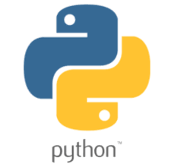

Requirements
PC or Laptop with atleast 4GB RAM
Python (version 3.7 and more)
Pycharm
Nltk library
Keras library
Pickle library
Pyttsx3 library
Flask Framework
Browser(Google chrome suggested)

Slide 6
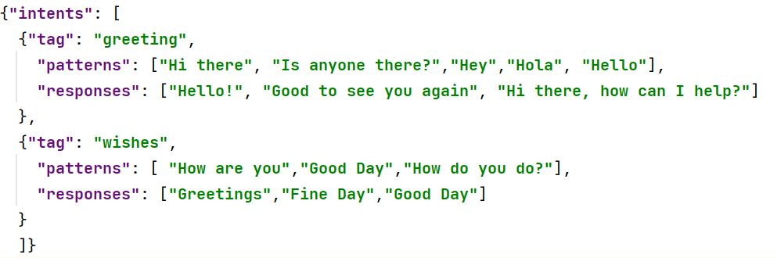
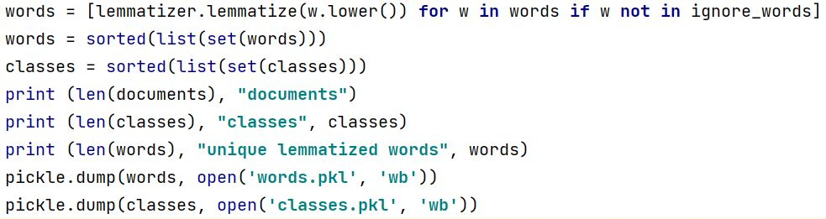
Design Process
Step 1: Make a json database that holds the various questions their responses along with a tag.
Step 2: Using nltk library, tokenize the sentences into separate words in the database. Lemmatize those words into their base form and store them in pickle files.

Slide 7
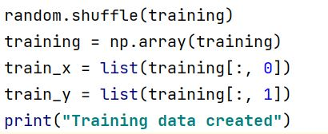
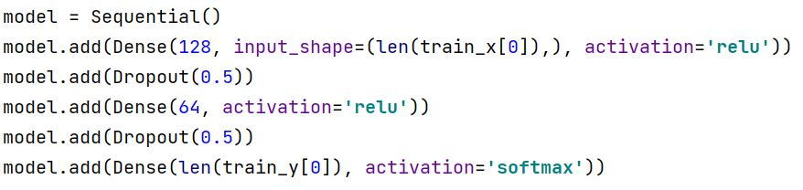
Design Process
Step 3: Convert this data into training data by dividing them into input (x-intents) and output (y-intents)
Step 4: Use Sequential model to create 2 Dense Layers of each 128 neurons and 64 neurons with activation function ‘relu’. After that create an output dense layer with activation function ‘softmax’.

Slide 8
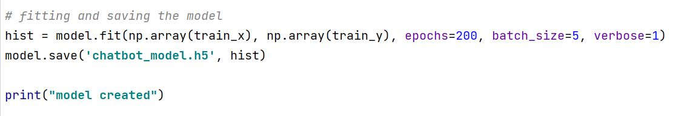
Design Process
Step 5: Use Stochastic gradient descent algorithm, to optimize the gradient descent.
Step 6: Fit the model using 200 epchos. Save the model along with weights in .h5 format

Slide 9
Implementation
The user first gives the input through the website
With the help of flask framework the input is passed to backend python code
Here first the input is preprocessed by removing extra spaces and symbols like ! , . etc.,
Now the input is sent to model to get the output string
This output string is again sent to webpage using the flask inbuilt methods
The output is displayed in the form of text and voice.

Slide 10
Flow chart
User gives input through webpage
Json database
Preprocess data in database
Prepare training dataset from the preprocessed data
Preprocess the input data
Predict the output by passing the preprocessed input into the model
Make a neural model of the required neurons
Train the model with the training dataset
Save model with weights in .h5 format
Display the output to the user through webpage

Slide 11
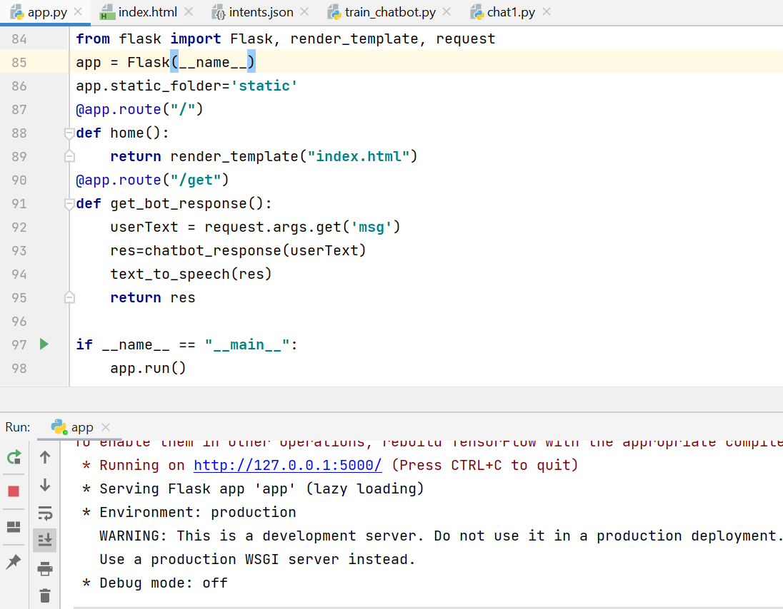
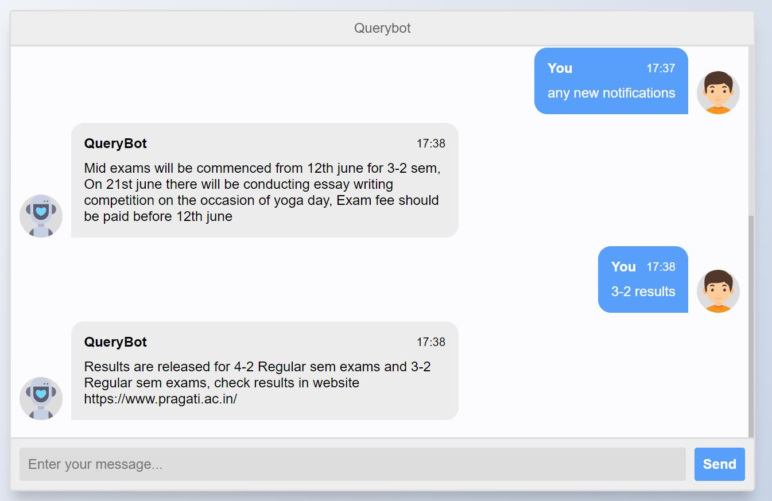
Overview

Slide 12
Conclusion
With the help of this application we can get any new notifications regarding college.
It is easy to handle
Anyone can use this application without any login.
References
https://python.plainenglish.io/create-a-deep-learning-chatbot-with-python-and-flask-d75396a4382a

Slide 13

Thank you

